Slide 1
The Optimal Boarding & Disembarking Method
IMMC 22768821
Shanghai Experimental School
1

Slide 2
Table of Contents
The Structure of Our Model
Analysis of the Problem
Optimization and Its Applications (Disembarking)
Sensitivity Analysis
Extensions of Our Model
Conclusion & Reflection
2

Slide 3
Part 1 The Structure of Our Model
IMMC 22768821
3

Slide 4
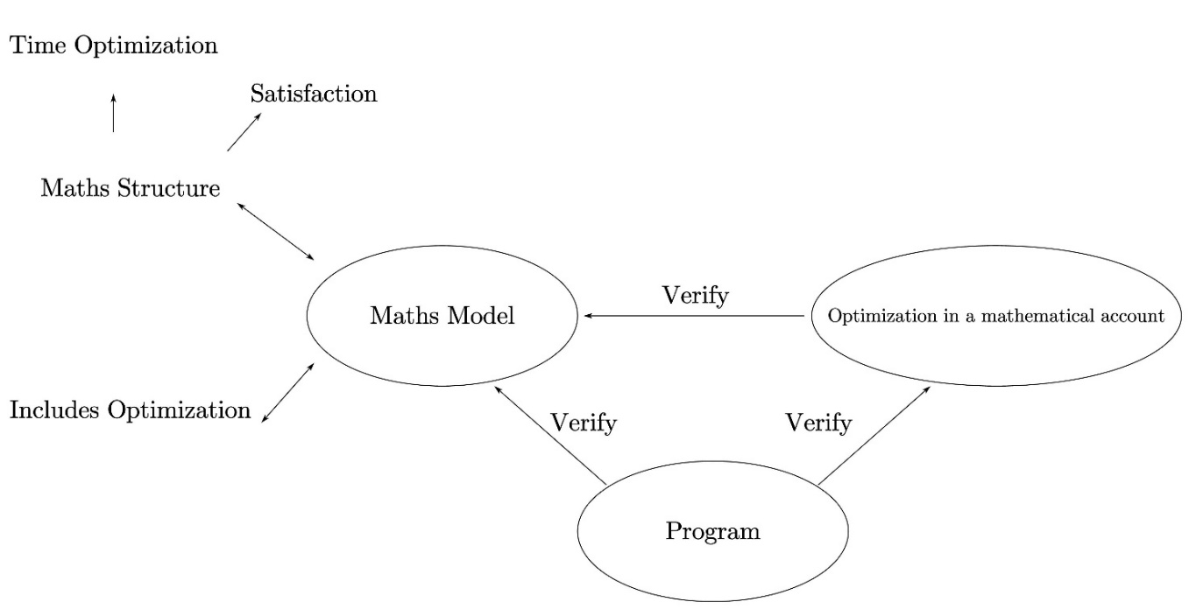
Model Analysis & Structure
What’s new?
Unlike conventional math modelling, mathematical analyses are included in our model.
This added part is mostly theoretical
What for?
It makes our logic more coherent, providing stout justifications for the intuitive notions & concepts raised in our model, as well as the results.
It significantly simplifies tedious calculations, especially during optimization.
It provides plausible strict mathematical explanations.
Fig. The Structure of Our Model
4

Slide 5
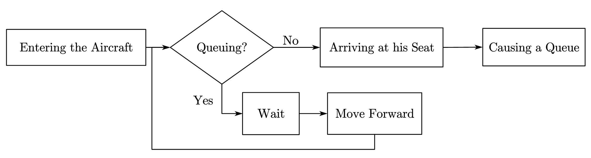
Passengers’ Behaviour
Fig. Flow Chart of Boarding
5

Slide 6
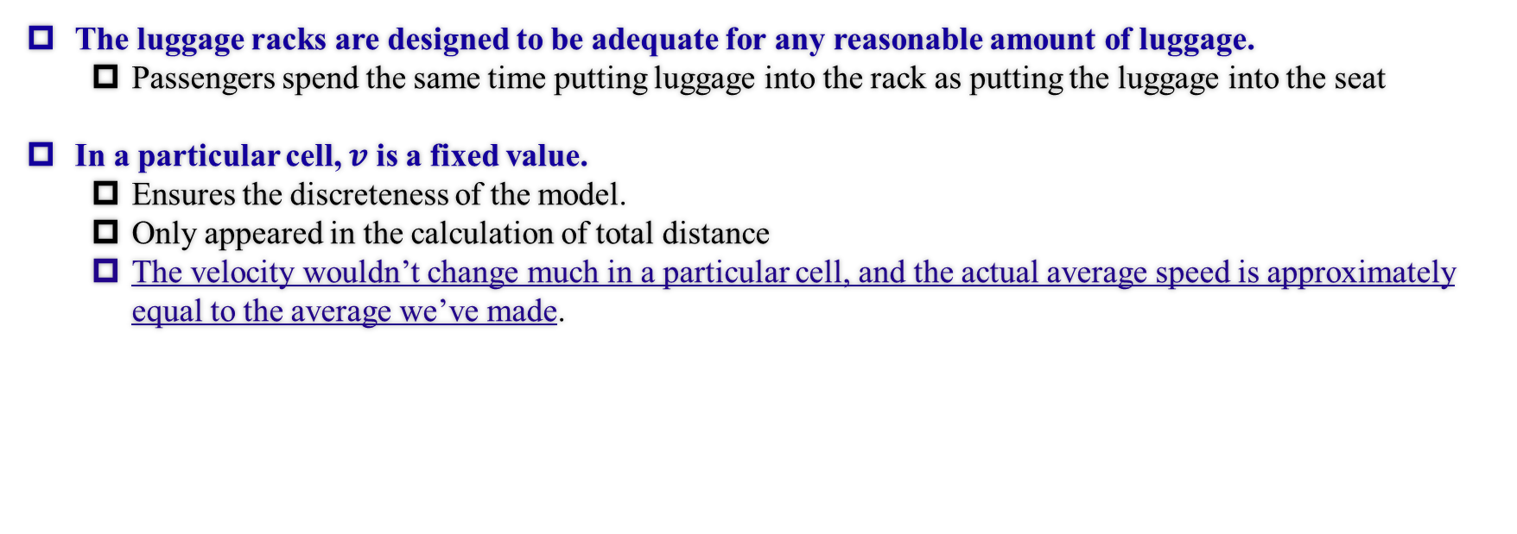
Critical Assumptions
The luggage racks are designed to be adequate for any reasonable amount of luggage.
Passengers spend the same time putting luggage into the rack as putting the luggage into the seat
In a particular cell, $v$ is a fixed value.
Ensures the discreteness of the model.
Only appeared in the calculation of total distance
The velocity wouldn’t change much in a particular cell, and the actual average speed is approximately equal to the average we’ve made.
6

Slide 7
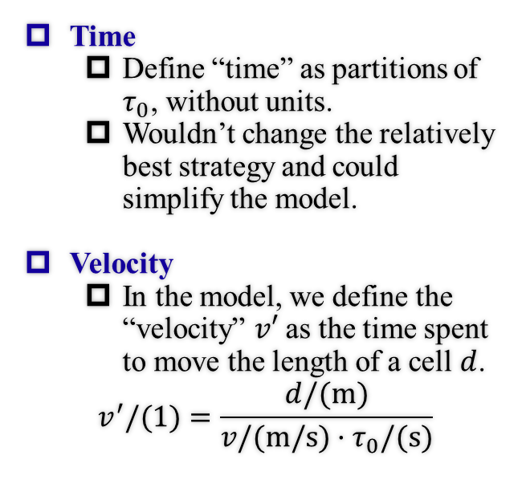
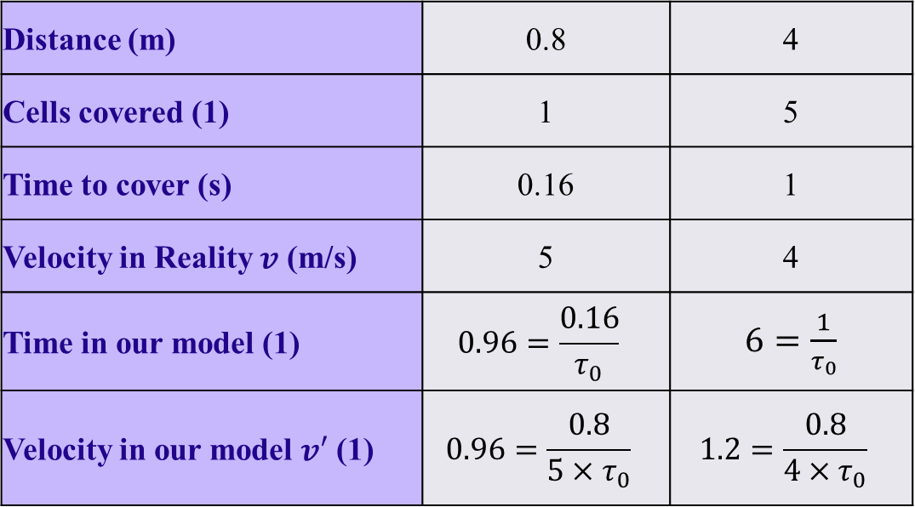
Definitions
Time
Define “time” as partitions of $τ_{0}$, without units.
Wouldn’t change the relatively best strategy and could simplify the model.
Velocity
In the model, we define the “velocity” $v′$ as the time spent to move the length of a cell $d$.
$$v^{′}/(1)=\frac{d/(m)}{v/(m/s)·τ_{0}/(s)}$$
Examples of our definitions for time and velocity
Distance (m) | 0.8 | 4
Cells covered (1) | 1 | 5
Time to cover (s) | 0.16 | 1
Velocity in Reality $v$ (m/s) | 5 | 4
Time in our model (1) | $$0.96=\frac{0.16}{τ_{0}}$$ | $6=\frac{1}{τ_{0}}$
Velocity in our model $v′$ (1) | $$0.96=\frac{0.8}{5×τ_{0}}$$ | $$1.2=\frac{0.8}{4×τ_{0}}$$
7

Slide 8
Part 2 Analysis of the Problem
IMMC 22768821
8

Slide 9
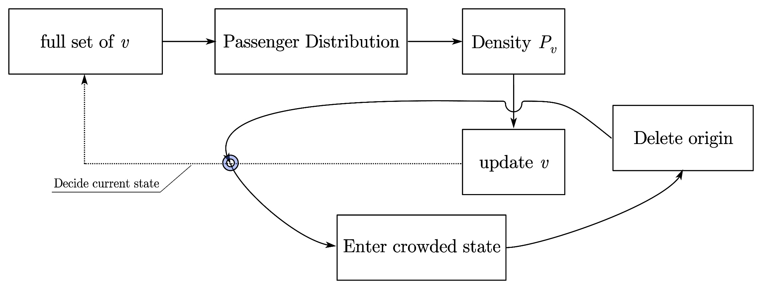
Overview of Math Model
Fig. Overview of Our Model
9

Slide 10
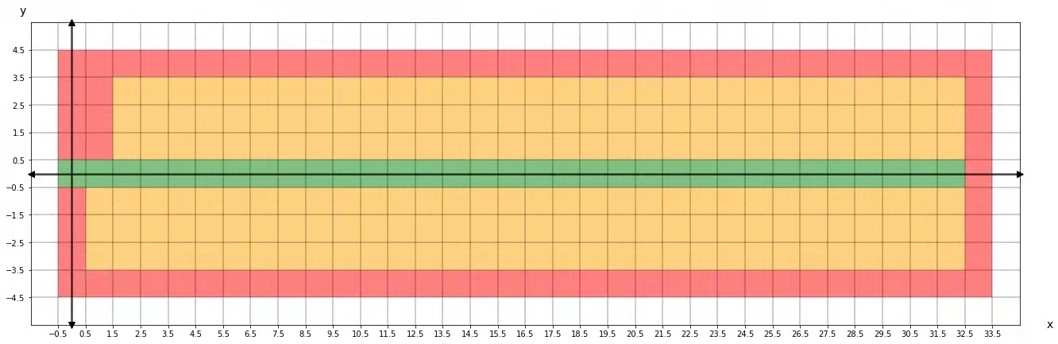
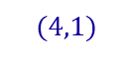
The Construction of the Coordinate
Figuratively understood as One-dimensional meshed finite element analysis
$$(4,1)$$
Cell 1
Cell 2
Fig. The Construction of the Coordinate
For example, this wall is still taken as several cells.
10

Slide 11

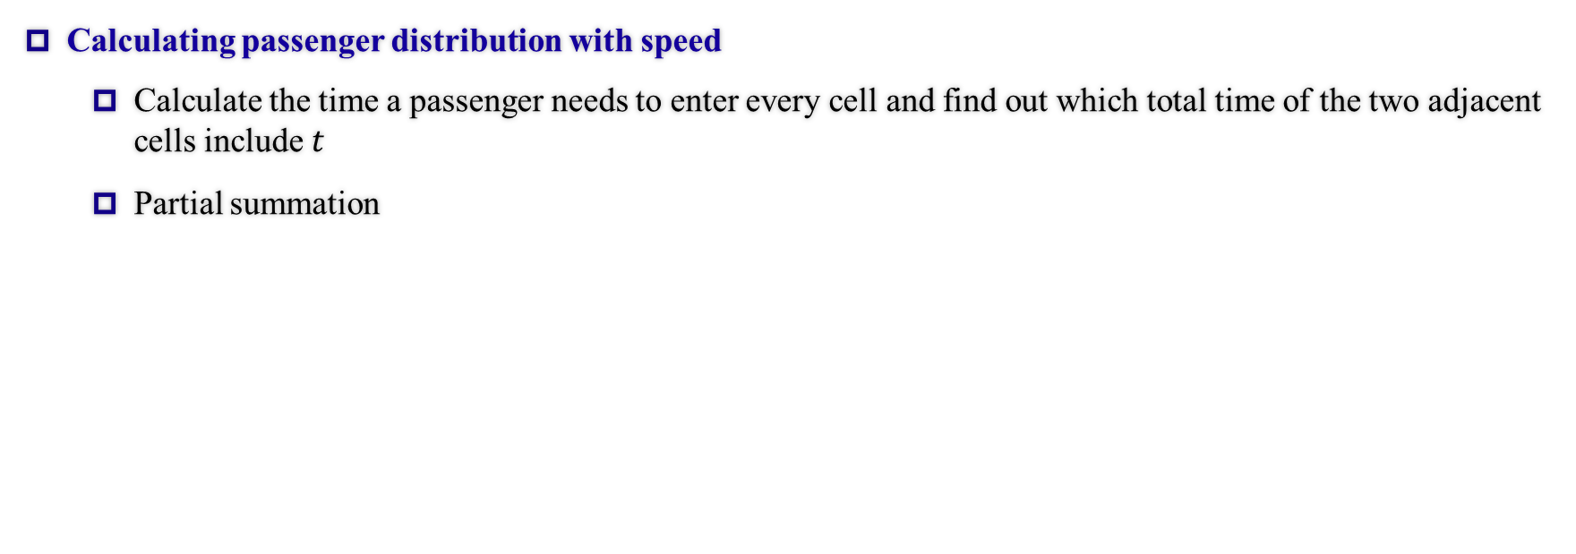

$$Full Set of v↔Distribution$$
Calculating passenger distribution with speed
Calculate the time a passenger needs to enter every cell and find out which total time of the two adjacent cells include $t$
Partial summation
11

Slide 12
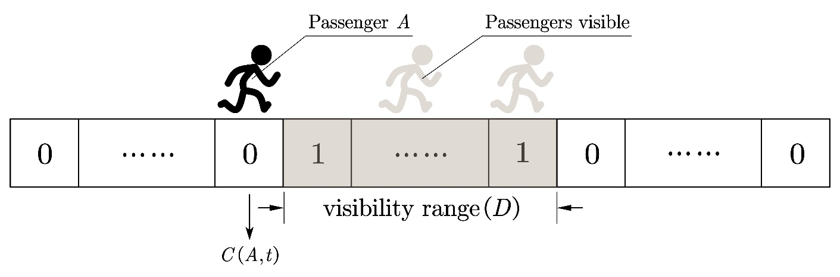

$$Distribution↔P_{v}$$
Calculating crowd density under a given passenger distribution
Calculated through the dot product of two vectors representing the passenger’s visibility and the overall distribution in the aisle. (or the existence factor)
Fig. The intuitive illustration of the visibility and existence vectors
12

Slide 13
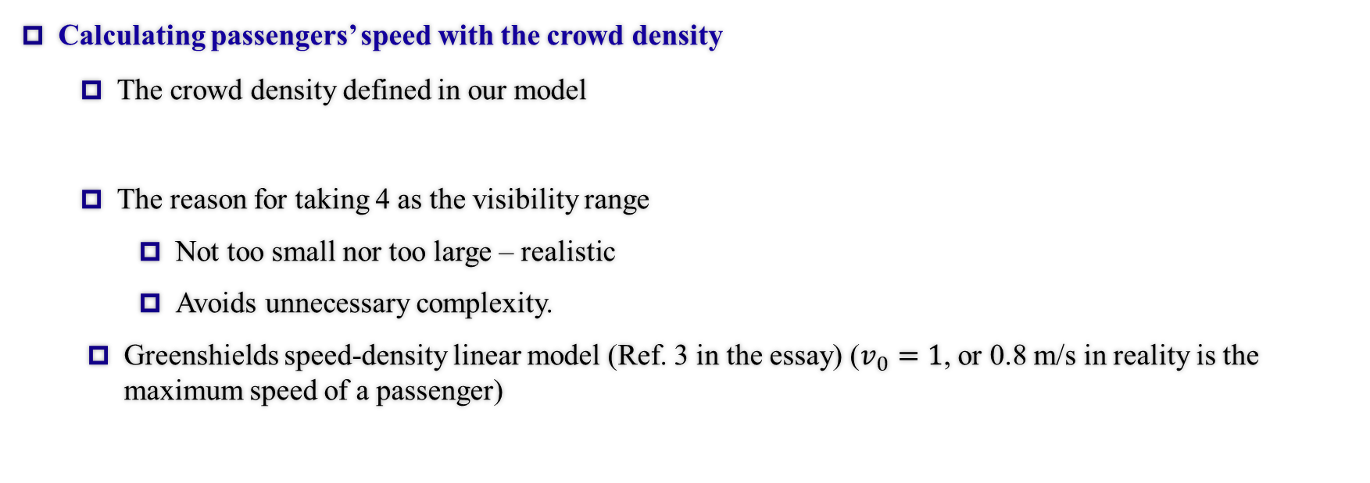
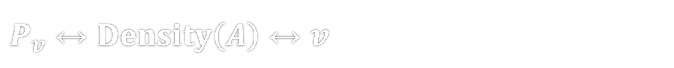
$P_{v}↔Density\left(A\right)↔v$
Calculating passengers’ speed with the crowd density
The crowd density defined in our model
The reason for taking 4 as the visibility range
Not too small nor too large – realistic
Avoids unnecessary complexity.
Greenshields speed-density linear model (Ref. 3 in the essay) ($v_{0}=1$, or 0.8 m/s in reality is the maximum speed of a passenger)
13

Slide 14

Passenger Demo
1
2
3
4
5
6
7
8
9
10
11
So now we’ve updated the velocity of $A$ by looking only at previous $v$!
Total time
$t$ occurs in cell $6$, then we take $C\left(A,t\right)=6$.
1
2
3
4
5
6
7
8
9
10
11
$$t$$
$$⇒v\left(A\right)=\frac{v_{0}}{1−Density(A)}=\frac{\frac{0.8}{0.8⋅τ_{0}}}{1−0.5}=12$$
$$P_{v}(A)$$
2
$$1$$
$$=$$
$$=$$
$$0.5=Density(A)$$
$$D$$
$$D$$
$$0$$
14

Slide 15
Overall Recursion Formula
The overall recursion formula we get
According to the inverse proportional relationship between real-life velocity and the velocity in our model, we’ll get a linear model. (This quality will be verified later in the Sensitivity Analysis part)
We did some algebraic simplifications by abstracting the variables into the form of linear combinations, and the final recursive result of the velocity can be written as below.
Although the mathematical simplifications might seem trivial, but this equation provides The Fundamental Bedrock for all the analyses & optimization afterwards.
15

Slide 16
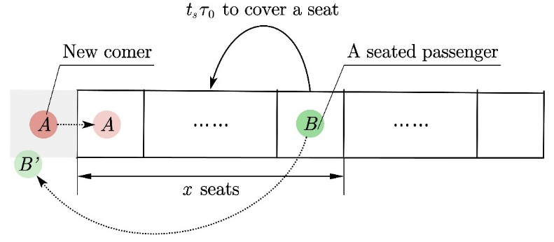
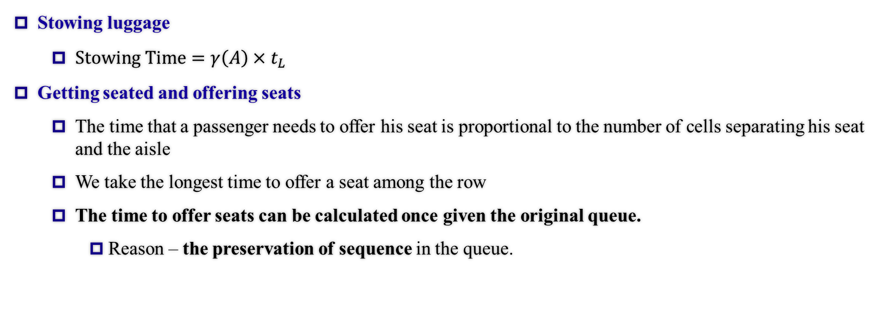
Congestion: Analysis of States
Standard Luggage Stowing Time
Stowing luggage
$Stowing Time=γ\left(A\right)×t_{L}$
Getting seated and offering seats
The time that a passenger needs to offer his seat is proportional to the number of cells separating his seat and the aisle
We take the longest time to offer a seat among the row
The time to offer seats can be calculated once given the original queue.
Reason – the preservation of sequence in the queue.
Discompliance Index
Fig. Offering a Seat
16

Slide 17
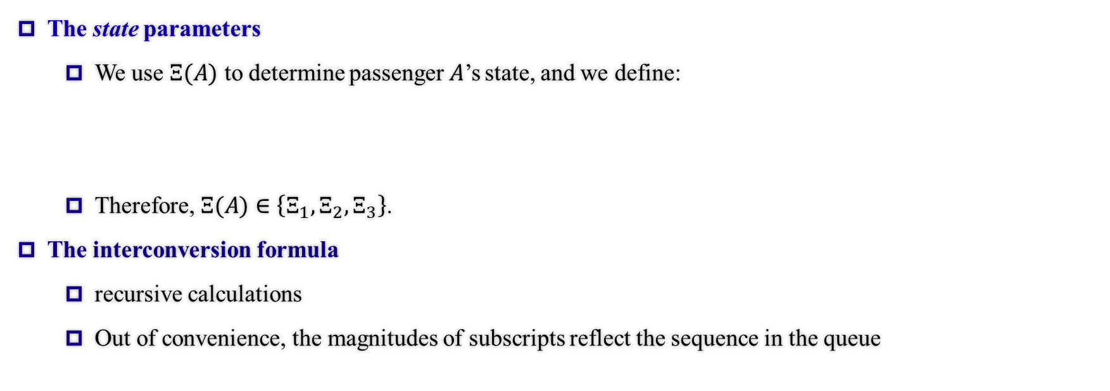
Congestion: State Description
The state parameters
We use $Ξ(A)$ to determine passenger$A$’s state, and we define:
Therefore, $Ξ(A)∈\left\{Ξ_{1}, Ξ_{2},Ξ_{3}\right\}$.
The interconversion formula
recursive calculations
Out of convenience, the magnitudes of subscripts reflect the sequence in the queue
17

Slide 18
Congestion: State Conversion
The interconversion formula
Updating the States:
Below is shown the mechanism, which fits our flow chart as shown in the beginning.
Deleting from the queue
When a passenger reaches his seat, we delete him from the queue to update and continue with the calculations without affecting the previous algorithm.
Preserves Linearity. (Matrix Multiplications)
18

Slide 19
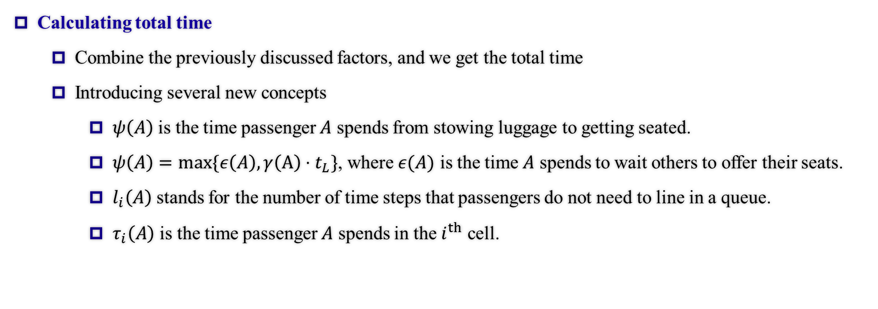
Total Time: Concepts
Calculating total time
Combine the previously discussed factors, and we get the total time
Introducing several new concepts
$ψ\left(A\right)$ is the time passenger $A$ spends from stowing luggage to getting seated.
$ψ\left(A\right)=max\{ε\left(A\right), γ\left(A\right)⋅t_{L}\}$, where $ε(A)$ is the time $A$ spends to wait others to offer their seats.
$l_{i}\left(A\right)$ stands for the number of time steps that passengers do not need to line in a queue.
$τ_{i}\left(A\right)$ is the time passenger $A$ spends in the $i^{th}$ cell.
19

Slide 20
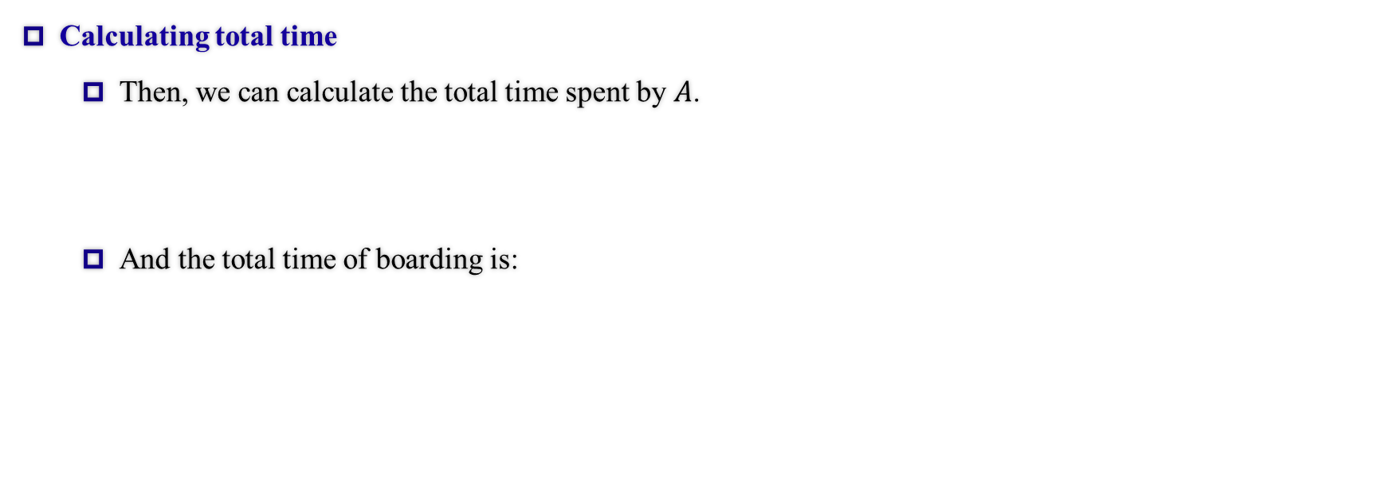
Total Time: Results
Calculating total time
Then, we can calculate the total time spent by $A$.
And the total time of boarding is:
20

Slide 21
Part 3 Optimization and Its Applications (Disembarking)
IMMC 22768821
21

Slide 22
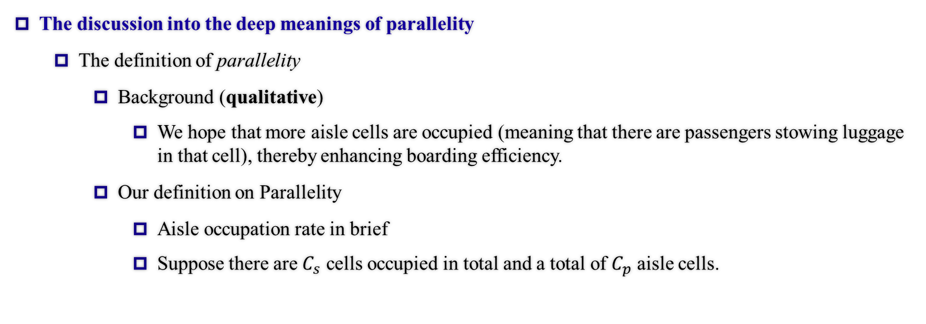
Parallelity: Qualitative
The discussion into the deep meanings of parallelity
The definition of parallelity
Background (qualitative)
We hope that more aisle cells are occupied (meaning that there are passengers stowing luggage in that cell), thereby enhancing boarding efficiency.
Our definition on Parallelity
Aisle occupation rate in brief
Suppose there are $C_{s}$ cells occupied in total and a total of $C_{p}$ aisle cells.
22

Slide 23
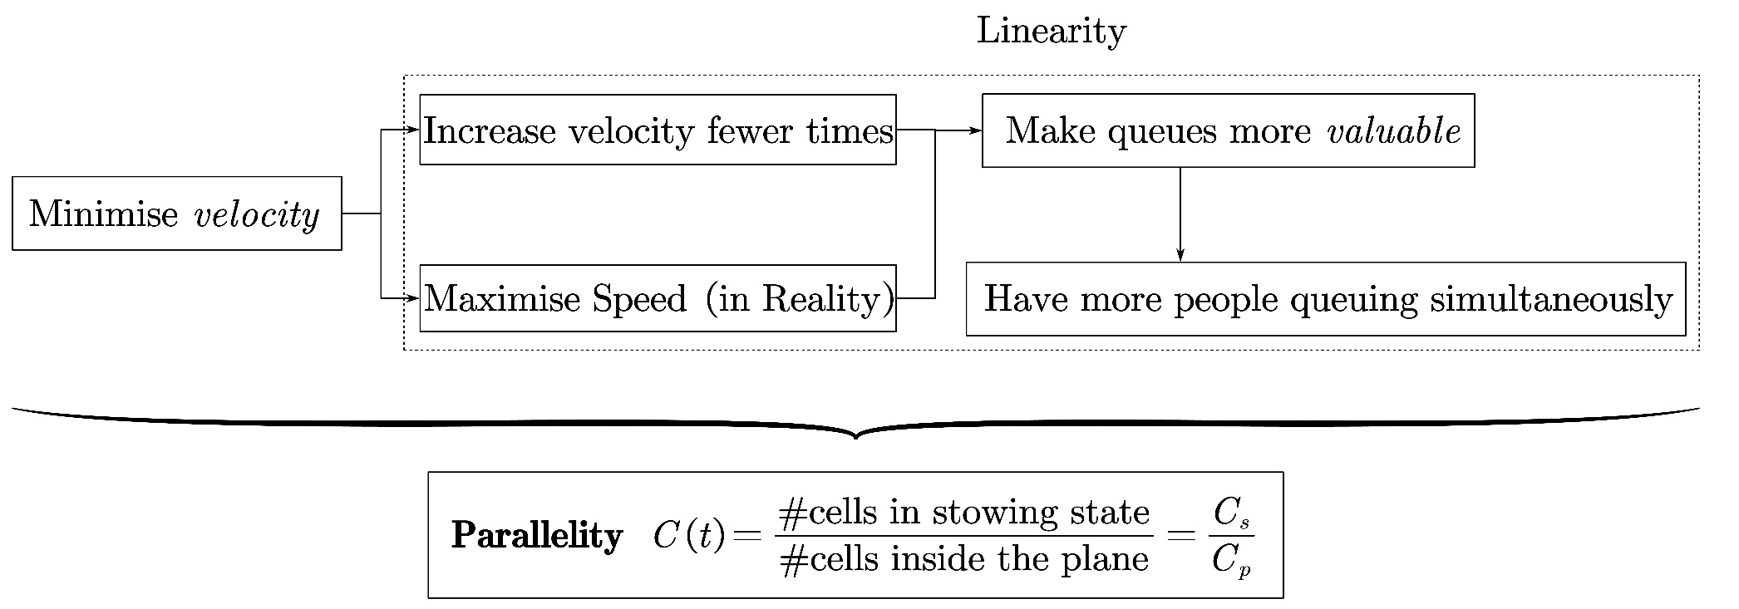
Parallelity: Semi-Quantitative Analysis
The discussion into the deep meanings of Parallelity
Model basis (semi-quantitative analysis)
23

Slide 24
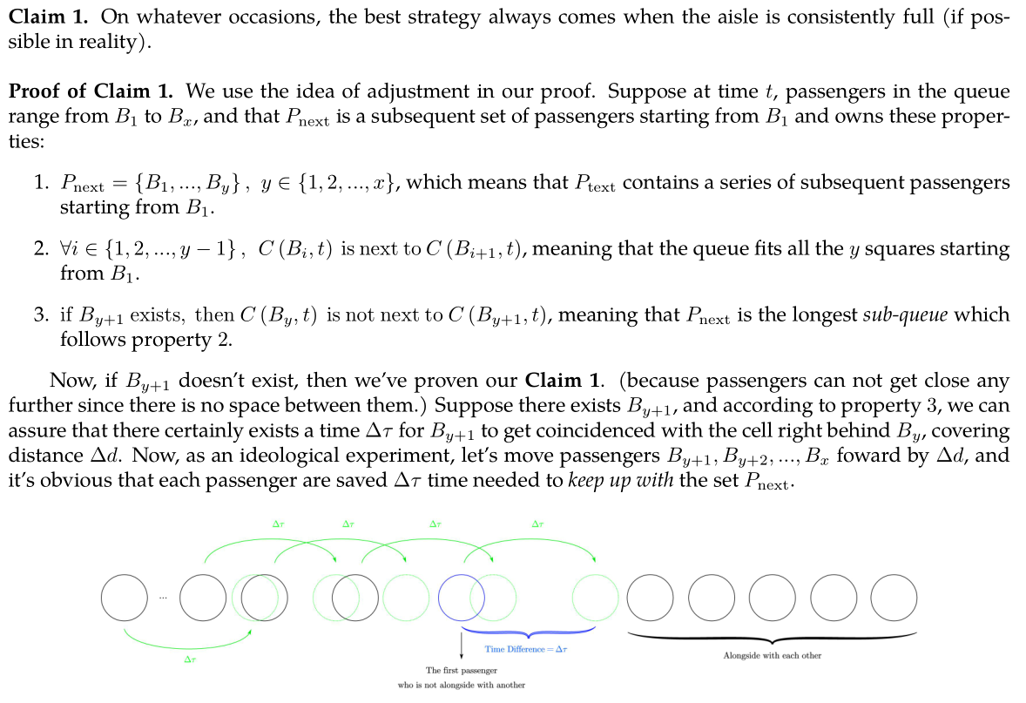
Parallelity: Quantitative
The discussion into the deep meanings of Parallelity
Mathematical deduction (quantitative analysis)
Claim 1 (the optimality of all cells being occupied)
This claim, on the other hand, also justified our model.
the adjustment method & analysis on idealistic circumstances
Claim 2 will appear later in the TETA and Flying Wing part.
We’ll not elaborate on the essay-based strict proof.
24

Slide 25
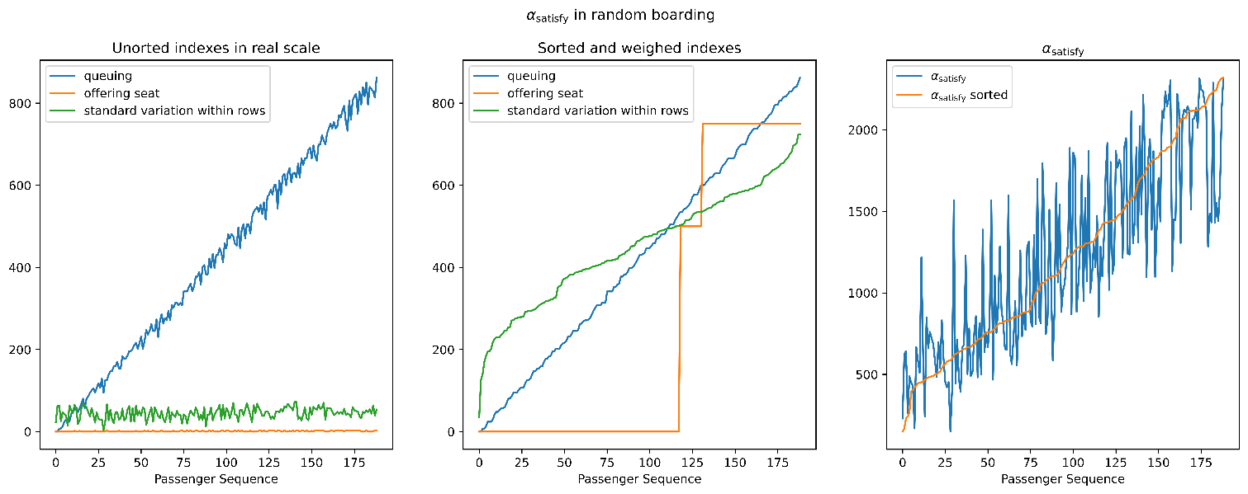
Satisfactory Index
Measures the dissatisfaction of passengers.
Queuing time
Time offering seats
Standard variance of the boarding time of same-row passengers
The total dissatisfaction is the weighted sum of the three factors, the weight respectively 1, 250 and 10.
25

Slide 26
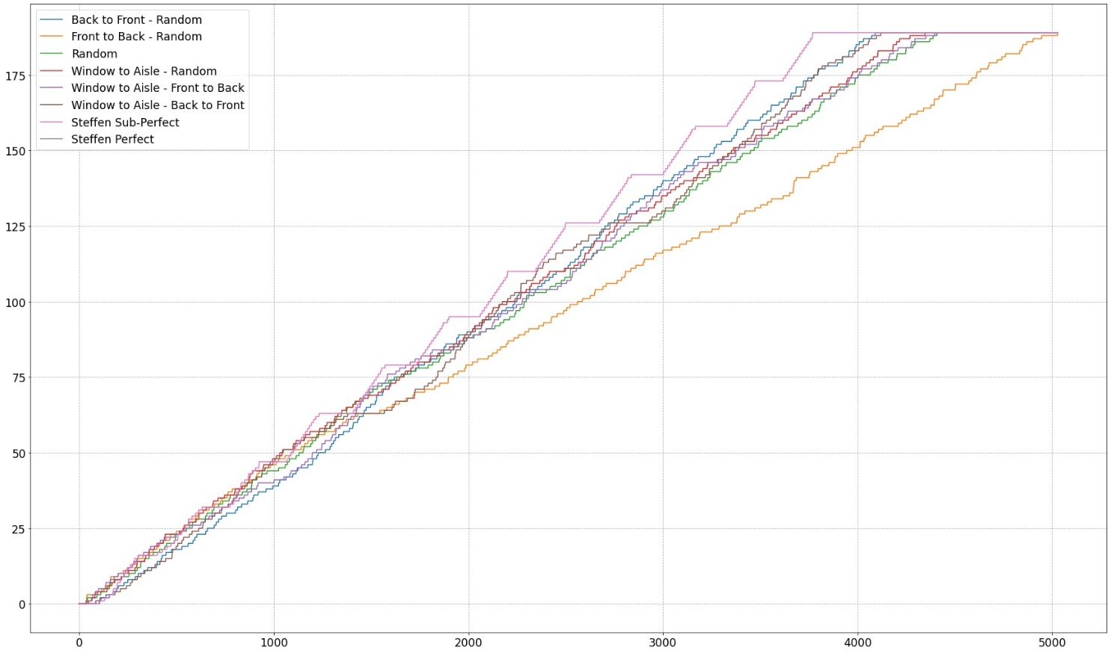
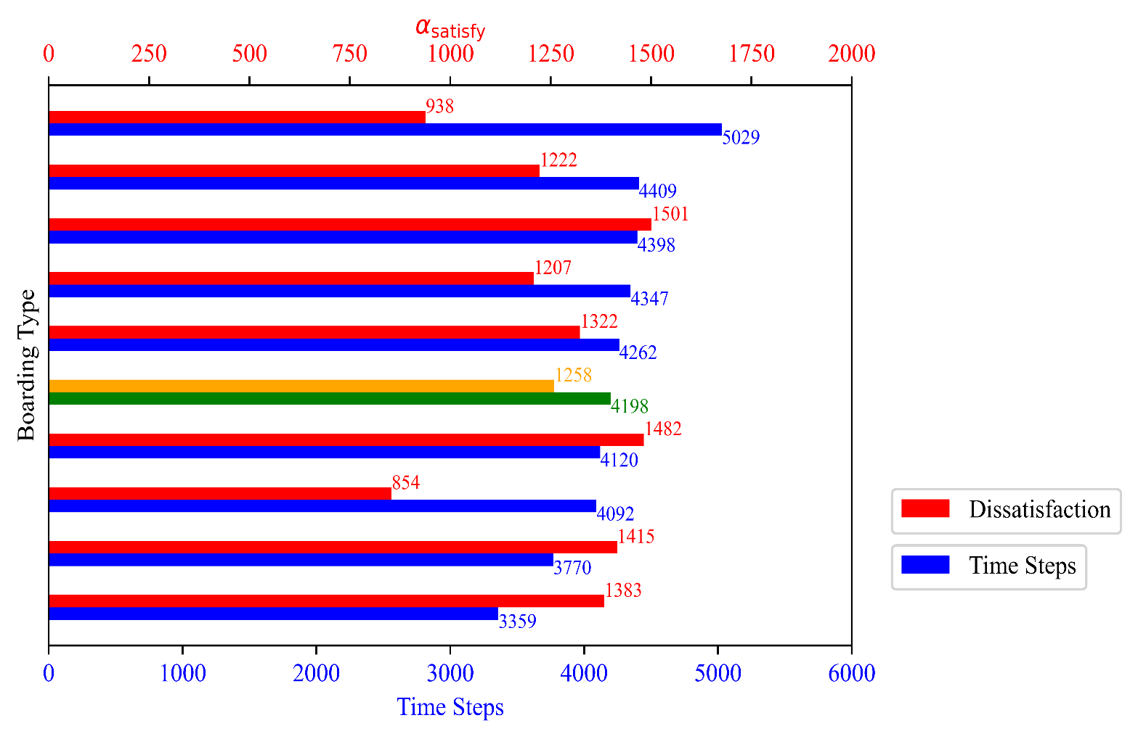
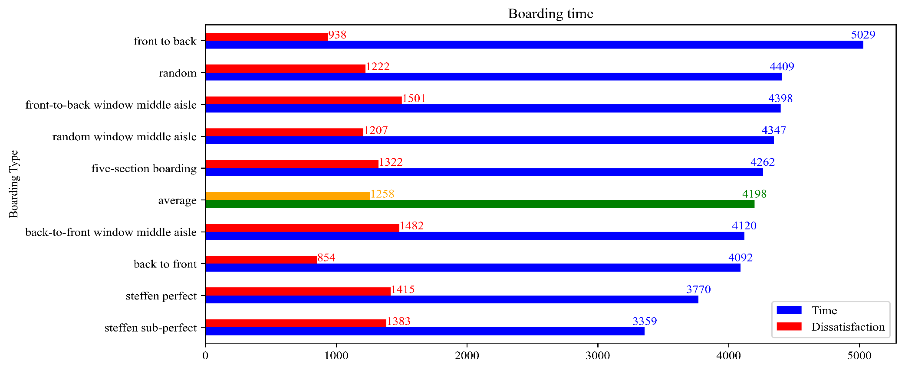
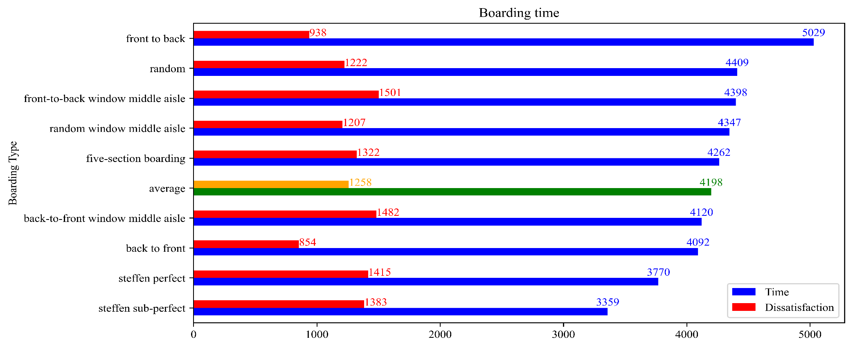


Results of Simulation: Graphs
26

Slide 27
Results of Simulation: Analysis
Shortest time: Steffen Sub-Perfect
Most Satisfactory: Back to Front
27

Slide 28
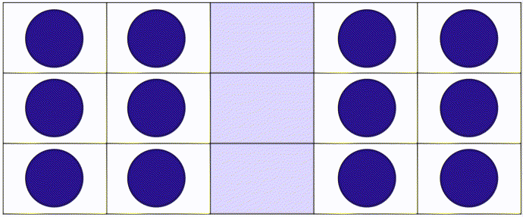
Modelling & Optimization of Disembarking
The starting point and destination of the passengers are exchanged.
The aisles are maximally utilized in terms of Parallelity.
No possibility of offering seats
Passengers queue as the ideal way, having higher Parallelity than boarding. Therefore, the time needed is shorter than boarding.
In a word, in disembarking, it’s possible to optimize boarding time and satisfaction at the same time.
Fig. The Optimal Disembarking Strategy
28

Slide 29
Part 4 Sensitivity Analysis
IMMC 22768821
29

Slide 30
Sensitivity Analysis: Results
Case 1: A Longer Stowing Time
Random boarding is the most sensitive while Front-to-Back method seems totally not sensitive
Case 2: Queue Jumping
Both Methods are Sensitive which makes a Big Impact on Total Results
Case 3: Reduction of Passengers
Random Boarding is the most Sensitive (Furthest Distribution of Points), Back-to-Front Method still not so sensitive
30

Slide 31
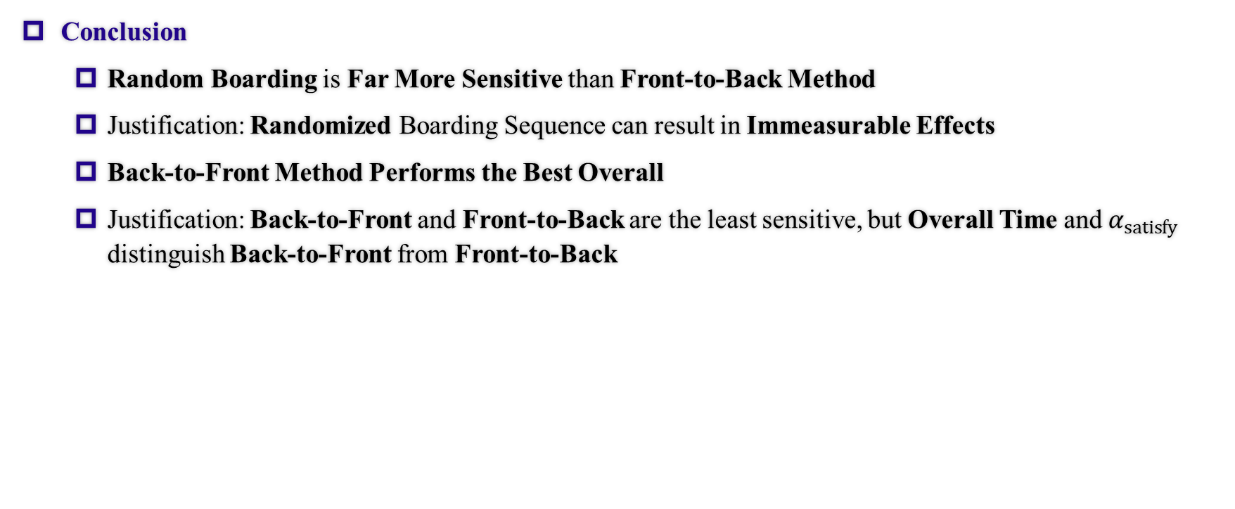
Sensitivity Analysis: Conclusion
Conclusion
Random Boarding is Far More Sensitive than Front-to-Back Method
Justification: Randomized Boarding Sequence can result in Immeasurable Effects
Back-to-Front Method Performs the Best Overall
Justification: Back-to-Front and Front-to-Back are the least sensitive, but Overall Time and $α_{satisfy}$ distinguish Back-to-Front from Front-to-Back
31

Slide 32
Part 5 Extensions of Our Model
IMMC 22768821
32

Slide 33
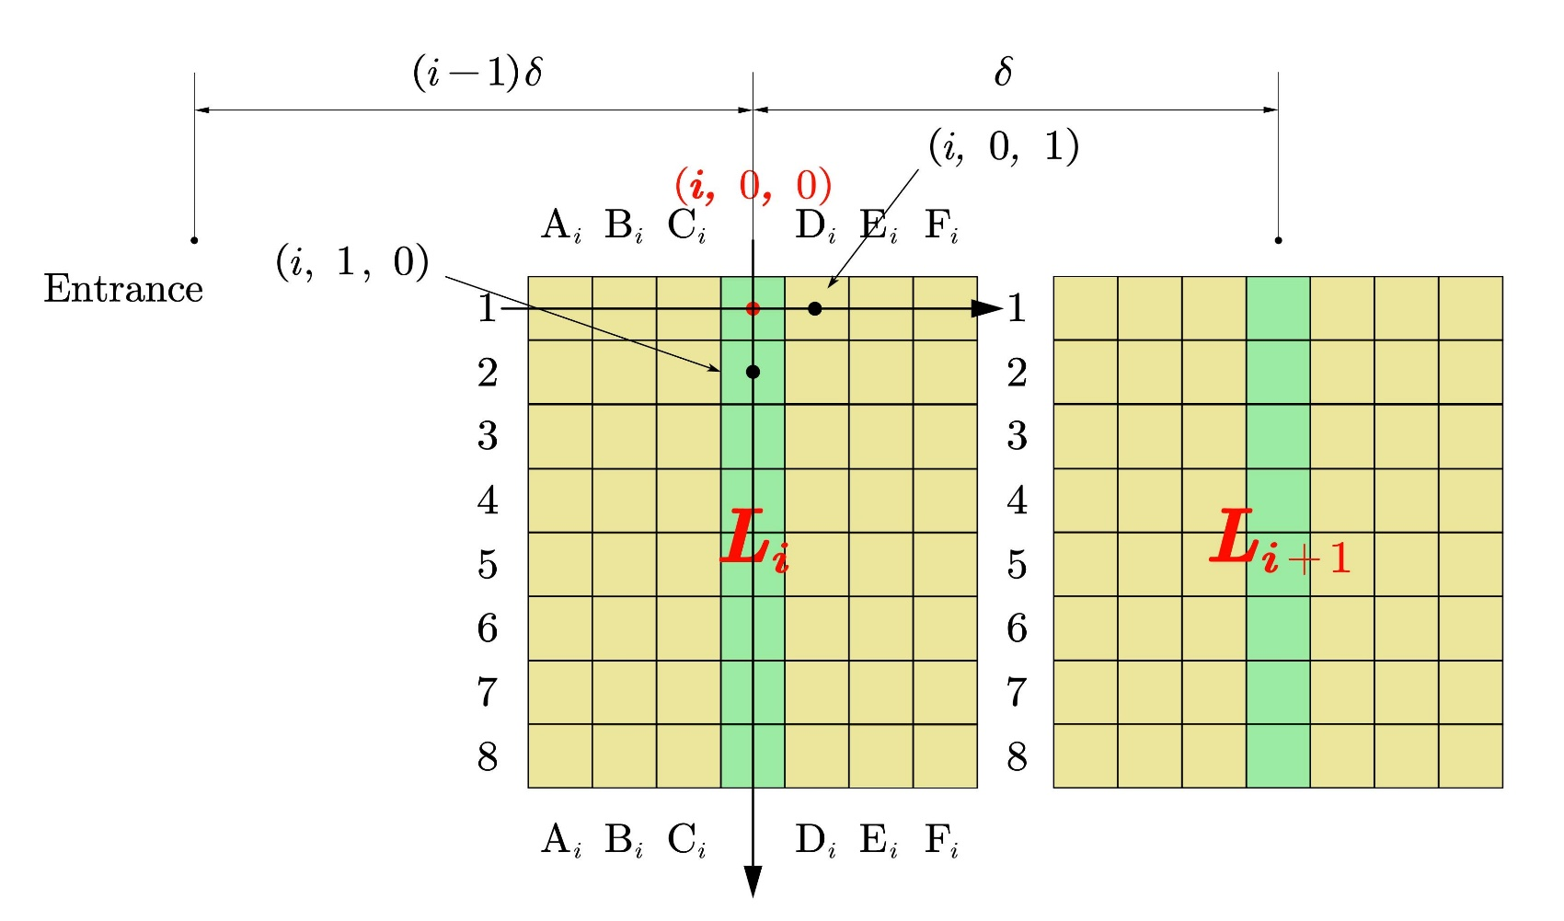
Coordinates: Flying Wing
Flying Wing Aircraft
We adopted three-dimensional coordinates.
We see every block as independent parts
Main Aisle Cells
Block Aisle Cells
Fig. Division of coordinates in Flying Wing
33

Slide 34
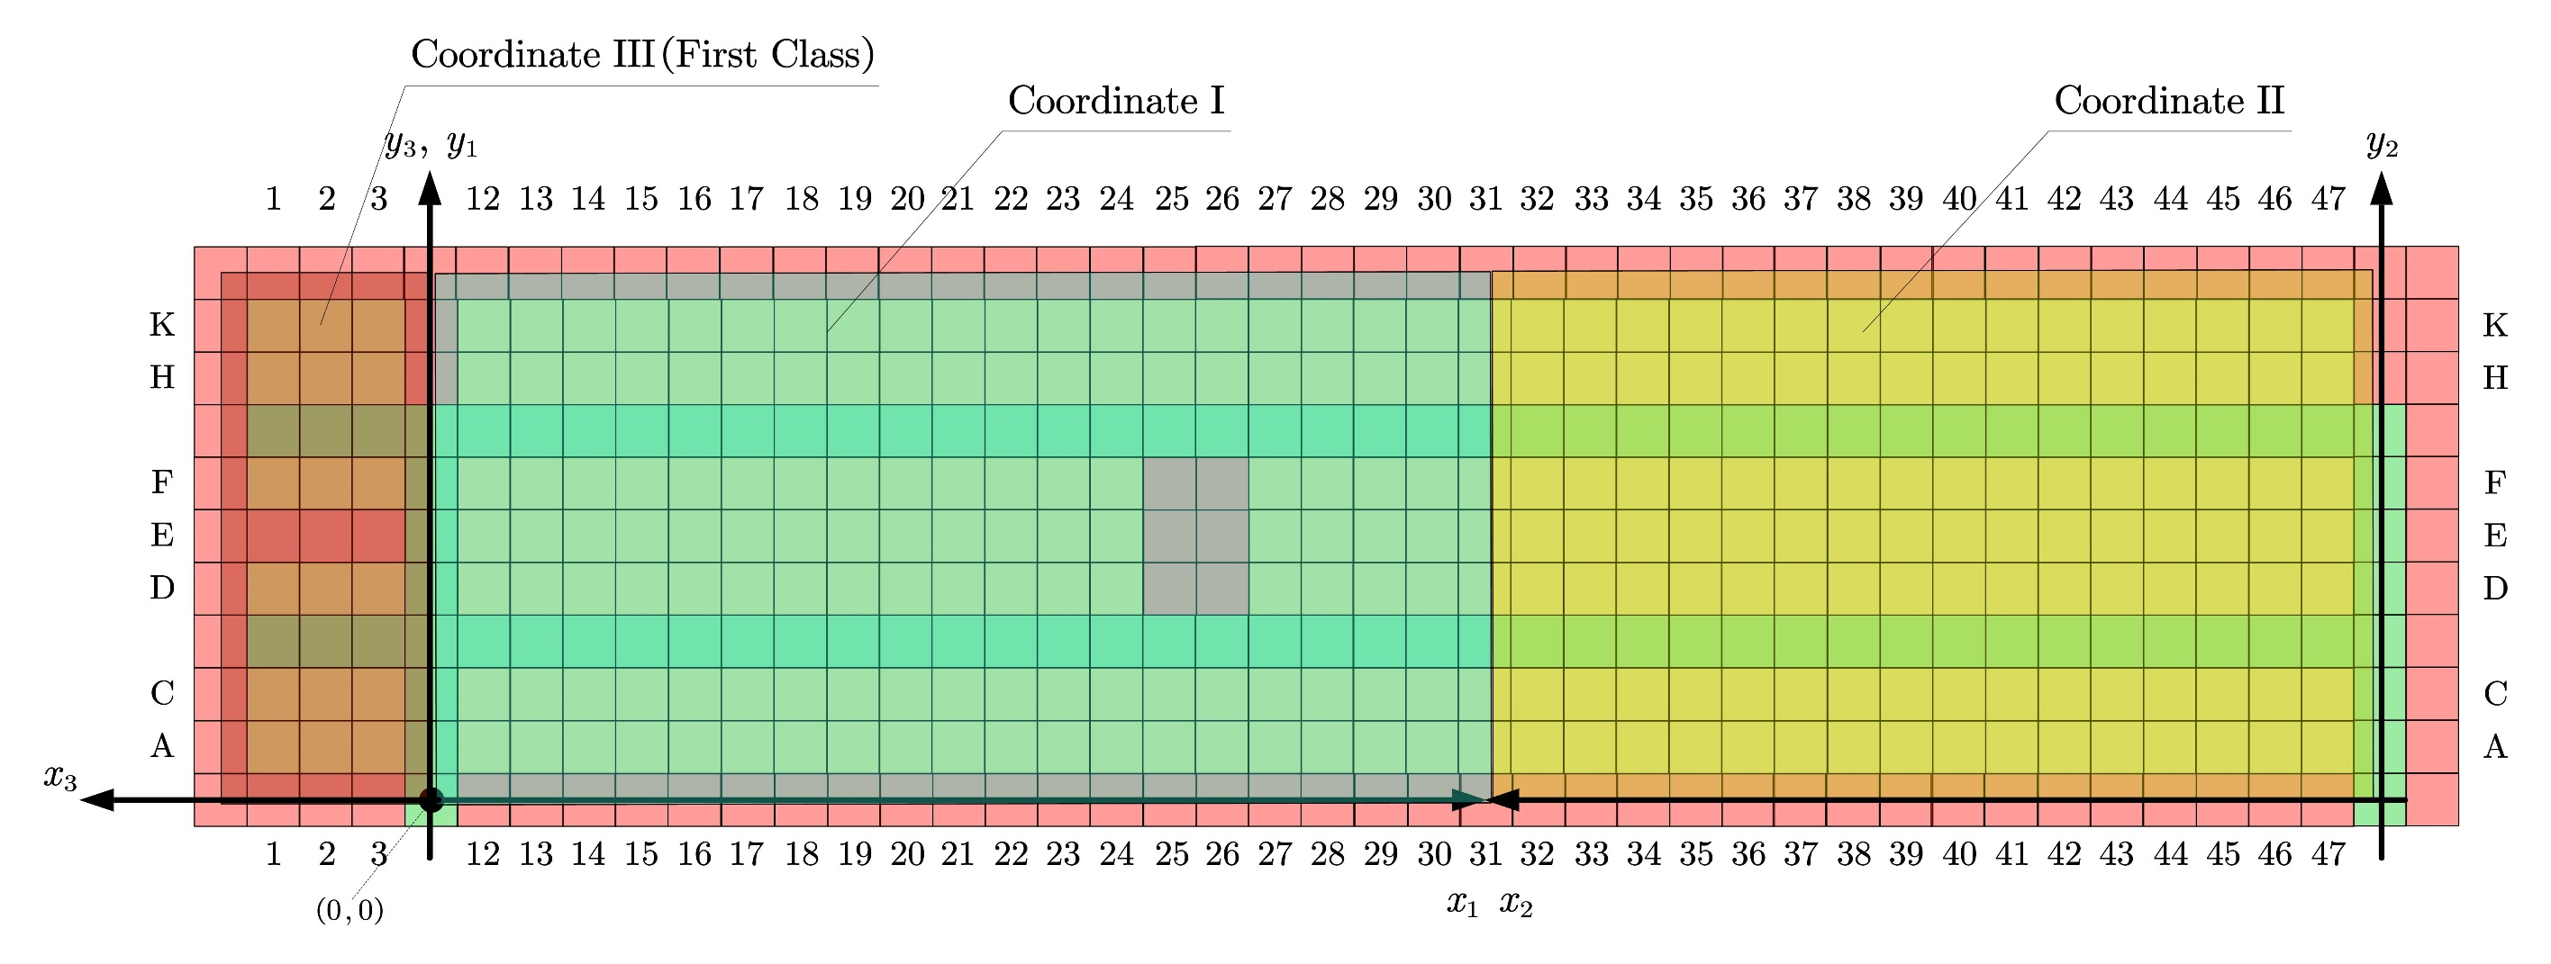
Coordinates: TETA
Fig. Division of coordinates in TETA
34

Slide 35
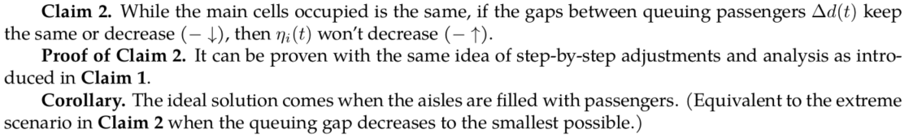
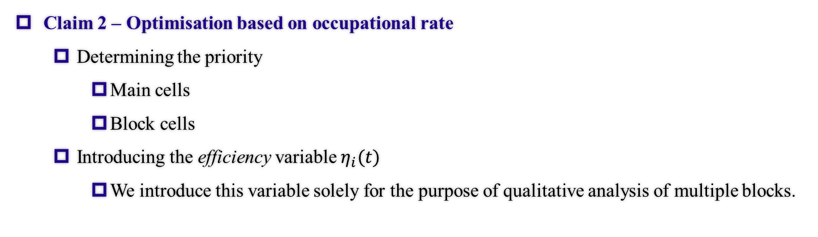
Optimisation: Occupational Rate
Claim 2 – Optimisation based on occupational rate
Determining the priority
Main cells
Block cells
Introducing the efficiency variable $η_{i}(t)$
We introduce this variable solely for the purpose of qualitative analysis of multiple blocks.
35

Slide 36
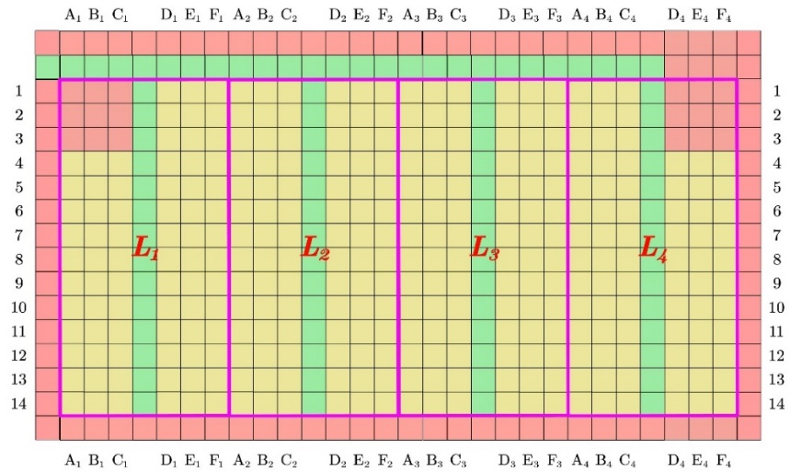
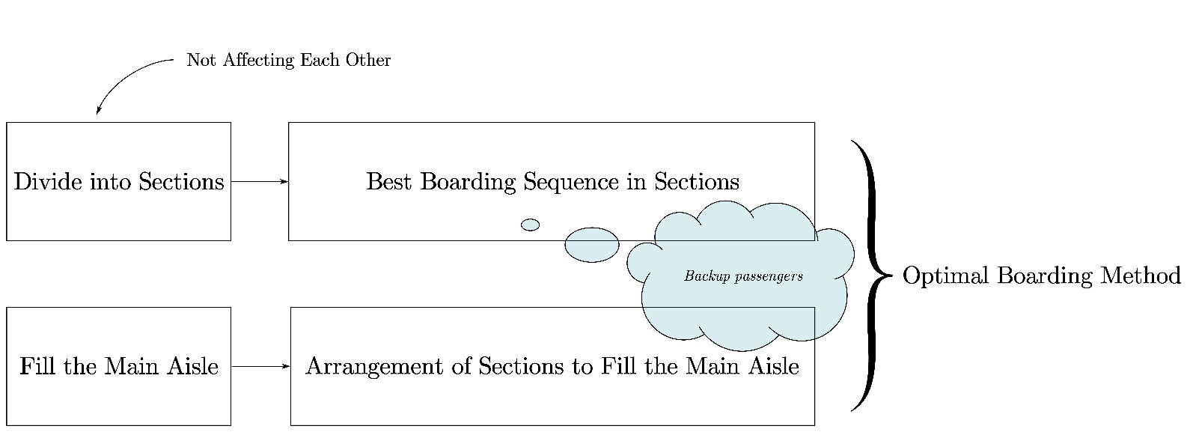
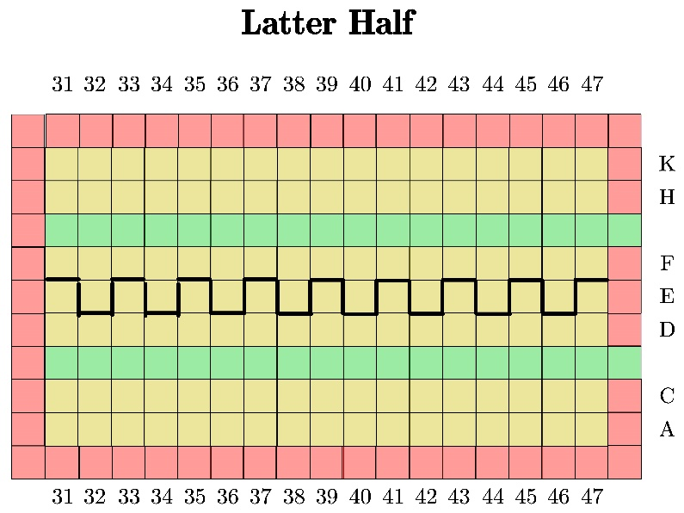
Optimisation: Optimal Boarding Method
Fig. Flow Chart for the Optimal Boarding Method
Two block division schemes
36

Slide 37
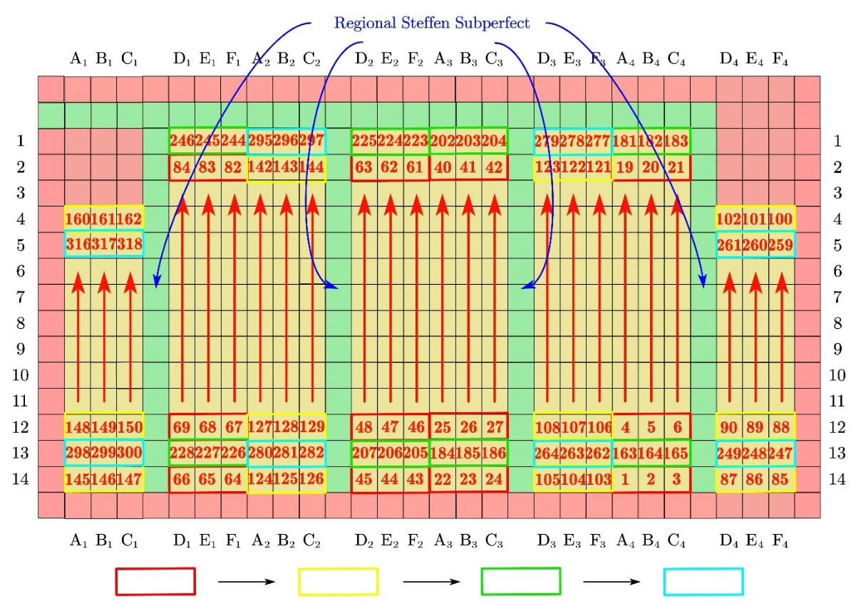
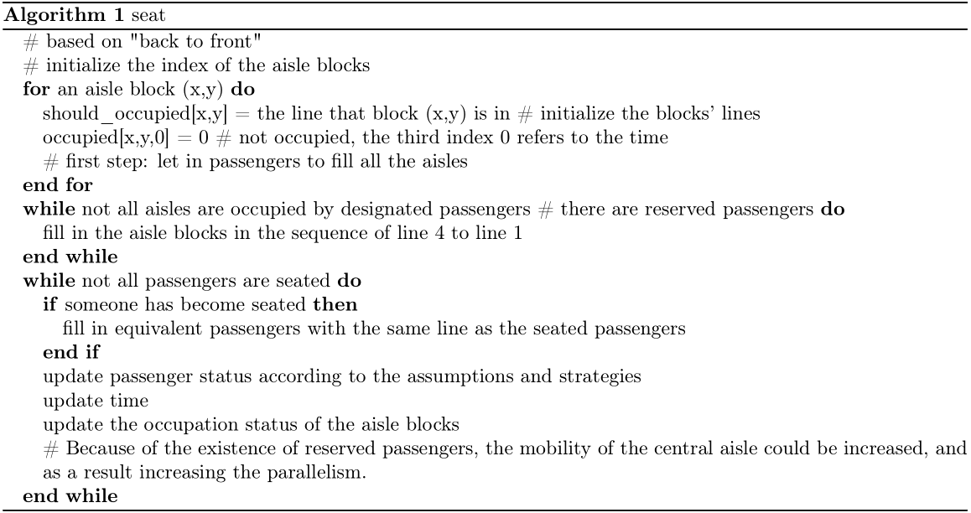
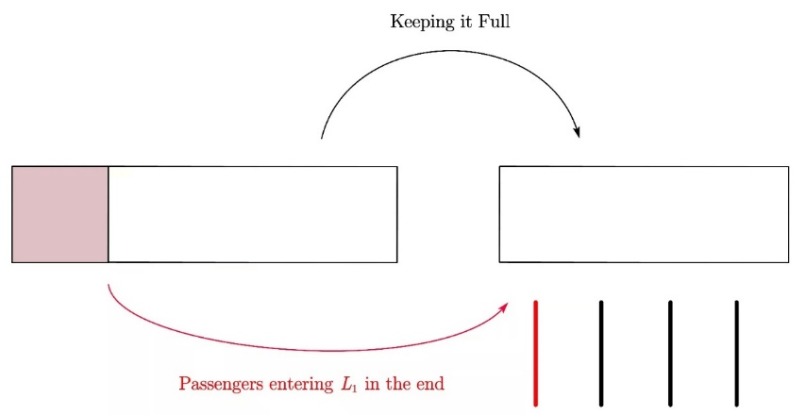
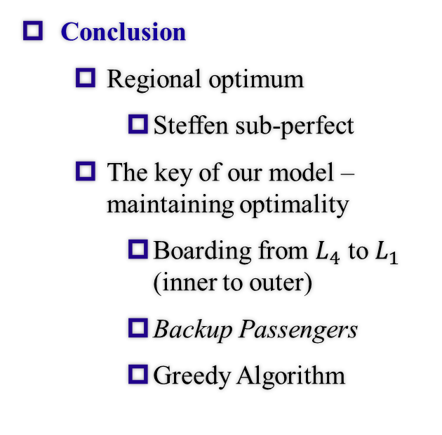
Optimisation & Conclusion: Flying Wing
Conclusion
Regional optimum
Steffen sub-perfect
The key of our model – maintaining optimality
Boarding from $L_{4}$ to $L_{1}$ (inner to outer)
Backup Passengers
Greedy Algorithm
Fig. Ideal Boarding Scheme
37

Slide 38
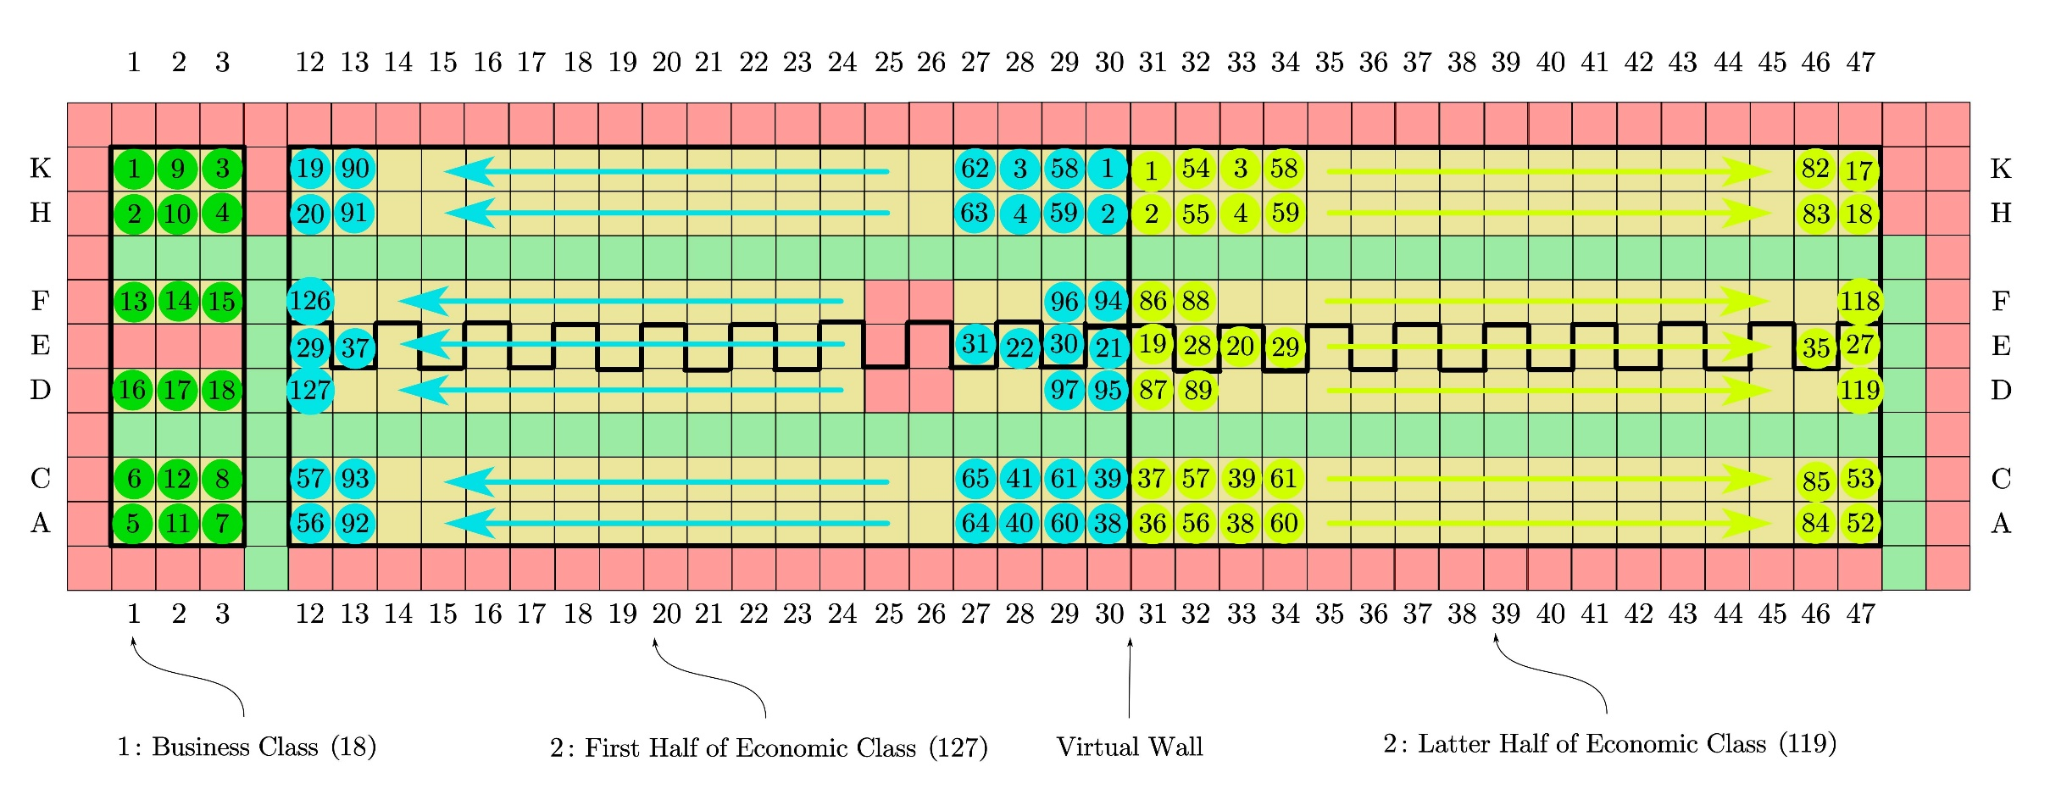
Conclusion: TETA
Conclusion
38

Slide 39
Part 6 Conclusion & Reflection
IMMC 22768821
39

Slide 40
Strengths & Weaknesses
Strengths
Accuracy
Universality
Efficiency
Weaknesses
Complexity
Difficult to Operate
40

Slide 41

Thanks For Listening!
SES stOOrz Math Modelling Group
IMMC 22768821
Shanghai Experimental School
41

Slide 42
Part 7 Appendix
IMMC 22768821
42

Slide 43
Hyperlinks
P3 Part 1 The Structure of Our Model
P4 Model Analysis & Structure
P5 Passengers’ Behaviour
P6 Critical Assumptions
P7 Definitions
P8 Part 2 Analysis of the Problem
P9 Overview of Math Model
P10 The Construction of the Coordinate
P11 Full Set of v↔Distribution
P12 Distribution↔P_v
P13 P_v↔Density(A)↔v
P14 Passenger Demo
P15 Overall Recursion Formula
P16 Congestion: Analysis of States
P17 Congestion: State Description
P18 Congestion: State Conversion
P19 Total Time: Concepts
P20 Total Time: Results
P21 Part 3 Optimization and Its Applications (Disembarking)
P22 Parallelity: Qualitative
P23 Parallelity: Semi-Quantitative Analysis
P24 Parallelity: Quantitative
P25 Satisfactory Index
P26 Results of Simulation: Graphs
P27 Results of Simulation: Analysis
P28 Modelling & Optimization of Disembarking
P29 Part 4 Sensitivity Analysis
P30 Sensitivity Analysis: Results
P31 Sensitivity Analysis: Conclusion
P32 Part 5 Extensions of Our Model
P33 Coordinates: Flying Wing
P34 Coordinates: TETA
P35 Optimisation: Occupational Rate
P36 Optimisation: Optimal Boarding Method
P37 Conclusion: Flying Wing
P38 Conclusion: TETA
P39 Part 6 Conclusion & Reflection
P40 Strengths & Weaknesses
Appendix
An Explanation for Velocity
Why D=4?
Using Matrixes to Describe Passenger States
Mathematical (Algebraic) Simplifications
The Essence behind Our Mathematical Model
The Calculation of l_i (A)
The Reasons behind Parallelity
The Core of the Disembarking Task
Satisfactory Index: Factors & Weights
Sensitivity Analysis: How?
Sensitivity Analysis: Case 1 Method
Sensitivity Analysis: Case 1 Result 1
Sensitivity Analysis: Case 1 Result 2
Sensitivity Analysis: Case 2
Sensitivity Analysis: Case 3
Block Division
Watch the demonstrations of the optimal boarding strategy
43

Slide 44
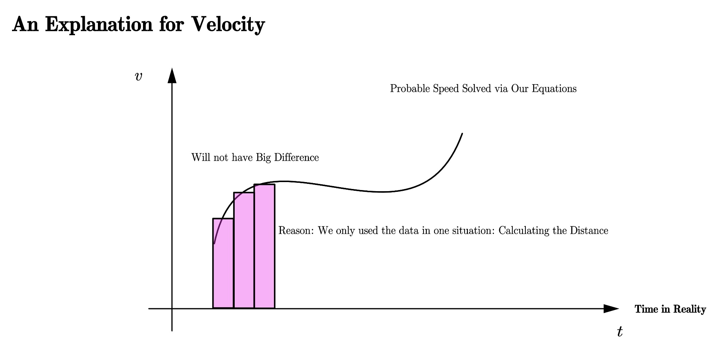
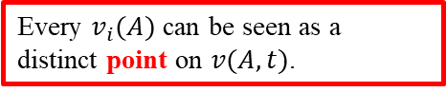
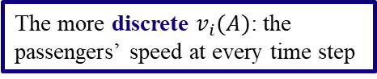
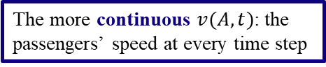
An Explanation for Velocity
The explanation for the last assumption made in the previous slide
The more continuous $v(A,t)$: the passengers’ speed at every time step
The more discrete $v_{i}(A)$: the passengers’ speed at every time step
Every $v_{i}(A)$ can be seen as a distinct point on $v(A,t)$.
Therefore, the summation (or integral) of these two defined velocities will roughly amount to the same value.
44

Slide 45

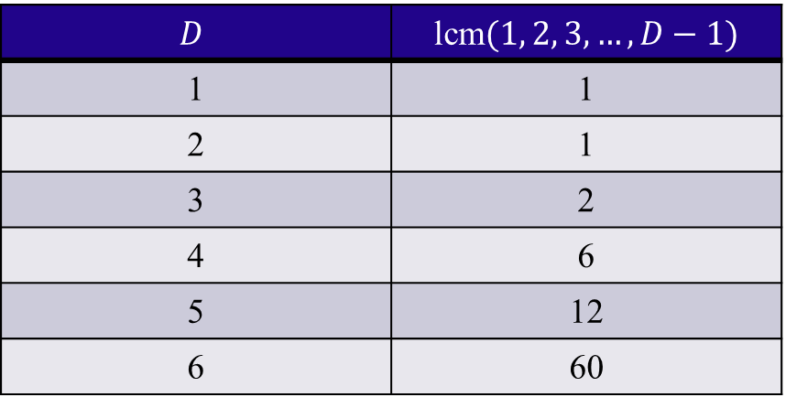
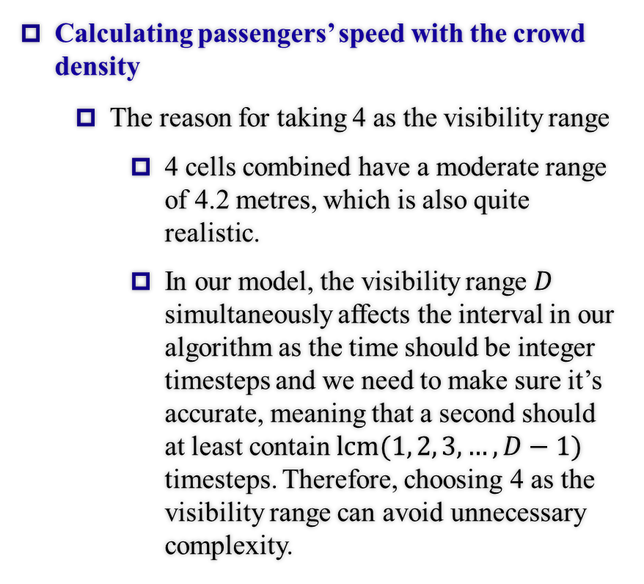
Why $D=4$?
Calculating passengers’ speed with the crowd density
The reason for taking 4 as the visibility range
4 cells combined have a moderate range of 4.2 metres, which is also quite realistic.
In our model, the visibility range $D$ simultaneously affects the interval in our algorithm as the time should be integer timesteps and we need to make sure it’s accurate, meaning that a second should at least contain $lcm(1, 2, 3, …, D−1)$ timesteps. Therefore, choosing 4 as the visibility range can avoid unnecessary complexity.
$$D$$ | lcm$(1, 2, 3, …, D−1)$
1 | 1
2 | 1
3 | 2
4 | 6
5 | 12
6 | 60
45

Slide 46
Using Matrixes to Describe Passenger States
Why?
To describe the states mathematically
The originally abstract states of passengers can be quantified
To ensure the linearity
The state Matrix can be calculated from the existing ones according to the recursion formula
46

Slide 47
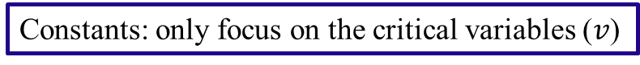
Mathematical (Algebraic) Simplifications
Why?
To make our model direct and clear.
Facilitate our calculation.
Avoid intermediate variables.
Prevent interference of irrelevant coefficients.
Ensure the model’s accuracy.
Facilitate our calculation.
Ensure that the logic of our model is coherent and rigorous.
Make the afterward analyses more intuitive
Lay the foundation for linear construction.
Direct and clear
Constants: only focus on the critical variables ($v$)
47

Slide 48
The Essence behind Our Mathematical Model
Make the model bear logic self-consistency.
The process of our model is complete.
Variable-based and accurate.
Make optimization process easy.
All the different occasions have been discussed in our model.
Simple formulas make it easier to be understood.
48

Slide 49
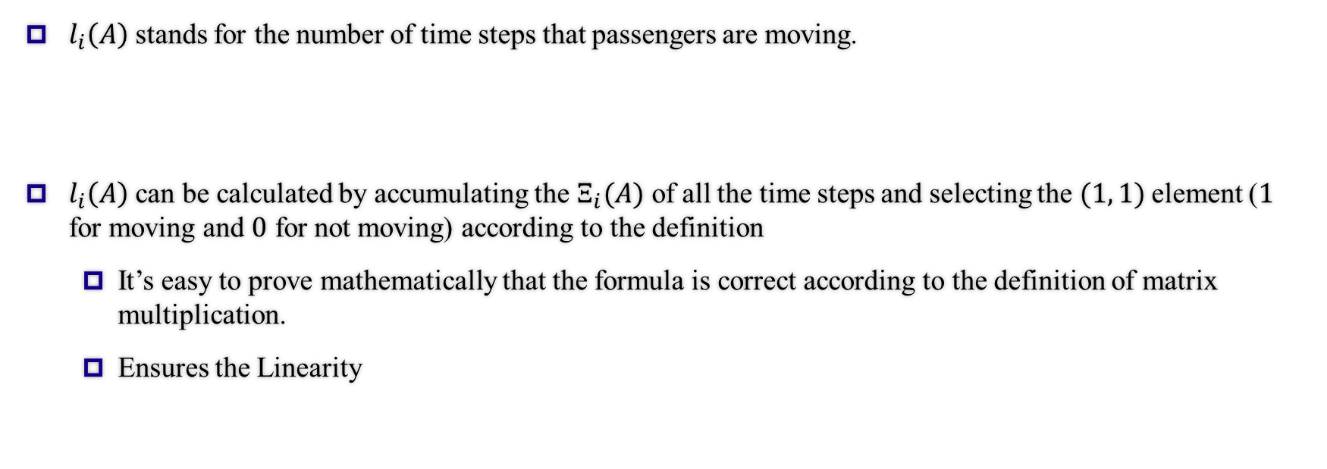

The Calculation of $l_{i}(A)$
$l_{i}\left(A\right)$ stands for the number of time steps that passengers are moving.
$l_{i}\left(A\right)$ can be calculated by accumulating the $Ξ_{i}(A)$ of all the time steps and selecting the $(1, 1)$element ($1$ for moving and $0$ for not moving) according to the definition
It’s easy to prove mathematically that the formula is correct according to the definition of matrix multiplication.
Ensures the Linearity
49

Slide 50
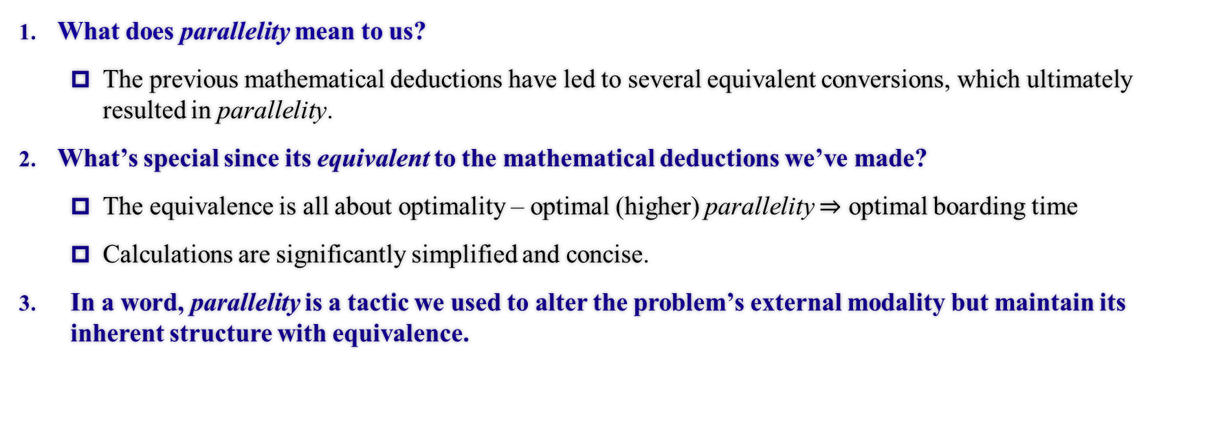
The Reasons behind Parallelity
What does parallelity mean to us?
The previous mathematical deductions have led to several equivalent conversions, which ultimately resulted in parallelity.
What’s special since its equivalent to the mathematical deductions we’ve made?
The equivalence is all about optimality – optimal (higher) parallelity $⇒$ optimal boarding time
Calculations are significantly simplified and concise.
In a word, parallelity is a tactic we used to alter the problem’s external modality but maintain its inherent structure with equivalence.
50

Slide 51
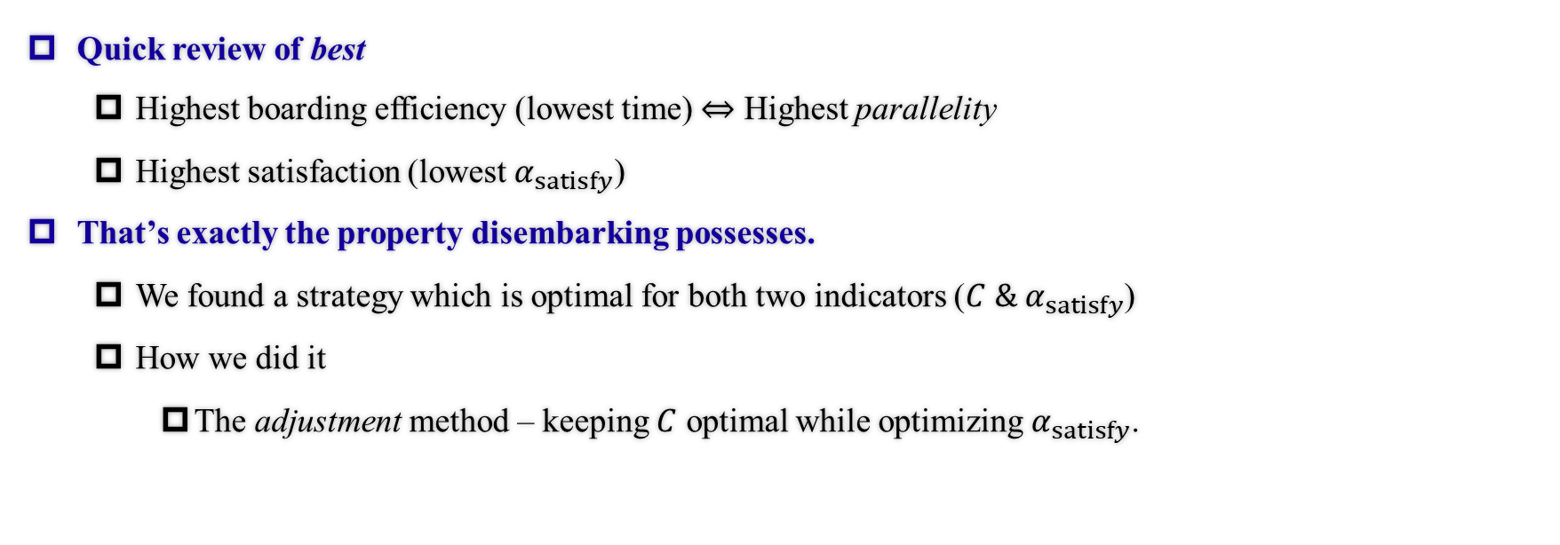
The Core of the Disembarking Task
Quick review of best
Highest boarding efficiency (lowest time) $⇔$ Highest parallelity
Highest satisfaction (lowest $α_{satisfy}$)
That’s exactly the property disembarking possesses.
We found a strategy which is optimal for both two indicators ($C \&{ α}_{satisfy}$)
How we did it
The adjustment method – keeping $C$ optimal while optimizing $α_{satisfy}$.
What if these two requisites are met simultaneously?
Queuing time
Time offering seats
Standard variance of the boarding time of same-row passengers
51

Slide 52
Satisfactory Index: Factors & Weights
What does the three factors stand for?
Queuing time
Time offering seats
Standard variance of the boarding time of same-row passengers
Families (or fellow passengers) may be separated
It was not directly shown in the essay, so we point this out for your reference.
Why 1, 250 and 10?
1 is for standardisation
Unite magnitudes & importance
Once united the magnitudes, the dissatisfaction index can rather equally reflect the three aspects of passengers’ satisfaction instead of tending to one of them.
It can make the ultimate dissatisfaction index of all passengers linear and plausible.
52

Slide 53
Sensitivity Analysis: How?
How to conduct a Sensitivity Analysis on Our Model?
Use Goodness of fit to measure in concrete figures
The higher the Goodness of fit, the more regular the data are and the less sensitive the strategy is.
Predictability of Changes
Relationship proved by Claims and Our Model
53

Slide 54
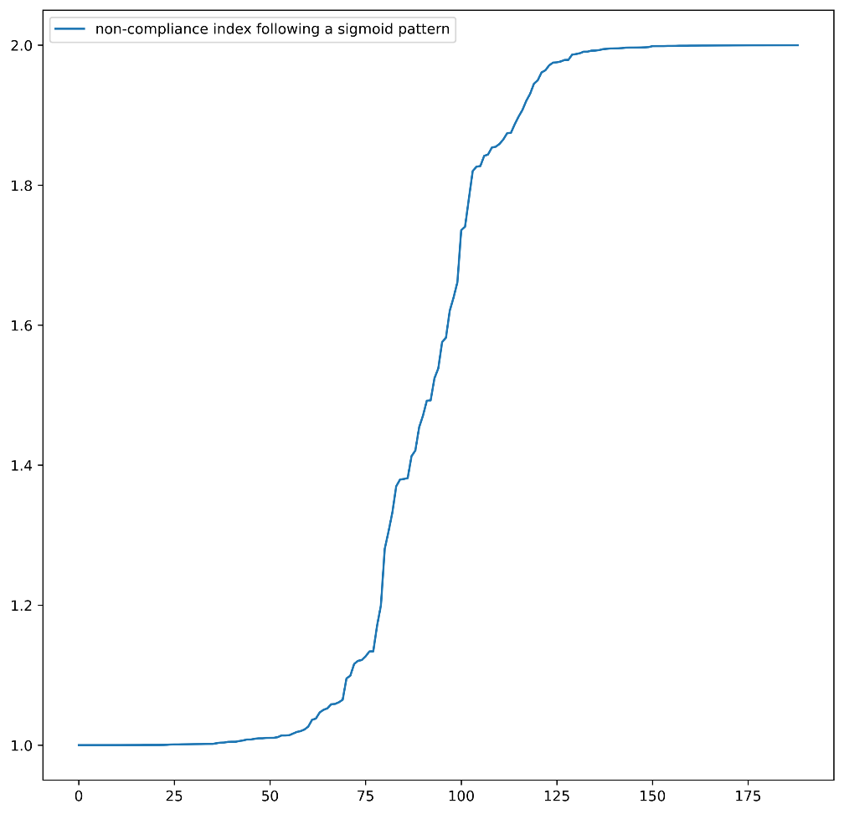

Sensitivity Analysis: Case 1 Method
Case 1: A Longer Stowing Time
We use Sigmoid Model for Random Distribution $σ\left(x\right)=−\frac{1}{1+e^{−x}}→σ^{′}(x)$
Commonly Used in Statistics
Usage determined by nature of function: $ℝ→$A Custom Range,
Reaching the limit at both ends with linear in the middle
Fig. Sigmoid Model Demonstration
54

Slide 55



Sensitivity Analysis: Case 1 Result 1
Case 1: A Longer Stowing Time
When considering the comparison on longer stowing time and variance, we define Stable functions as those with Linear graphs. Both the functions of Front to Back and Back to Front are upper convex followed by linear, while Random without obvious patterns. Thus Random boarding is the most sensitive, as it’s the only Unstable graph.
Fig. Comparison on Longer Stowing Time, Variance
55

Slide 56



Sensitivity Analysis: Case 1 Result 2
Case 1: A Longer Stowing Time
Random boarding is the most sensitive while Front-to-Back method seems totally not sensitive, as the points on the second graph (random) are farther from the line than that of the other two graphs and thus the goodness of fit is lower.
Fig. Comparison on Longer Stowing Time, Overall Time
56

Slide 57


Sensitivity Analysis: Case 2
Case 2: Queue Jumping
Both Methods are Sensitive which makes a Big Impact on Total Results, as shown on the graph, the points are irregularly distributed.
Fig. Comparison on Queue Jumping
57

Slide 58



Sensitivity Analysis: Case 3
Case 3: Reduction of Passengers
Random Boarding is the most Sensitive (Furthest Distribution of Points), Back-to-Front Method still not so sensitive
Fig. Comparison on Reducing Passengers
58

Slide 59
Block Division
We divide the multi-aisle aircrafts into several blocks according to aisles.
Can unify the models as each block is similar to one-aisle aircraft
Is plausible because there would be no inter-aisle disruption
Our work reduced to finding the best in-block and between-block strategies
Only to find the between-block sequence as we can use the previously shown in-group sequence (similar to one-aisle aircraft strategy)
59

